Slide 1




HardnBot Intelligent Server Hardening Software

Slide 2


HardnBot Solution Proposed in Brief
Fully automated operations.
Perform scans to detect compliance issues.
Classify compliance issues according to a risk score.
Predict the overall risk score of the server.
Backup system configurations.
Brings industry best practices into your system configurations.
Apply fixes upon user confirmation.
Automatically harden the system to classified compliance issues.
Automatically rollback when abnormal behavior is detected.

Slide 3
Task | W.M.K.M.W Wijekoon IT16167742
100%
Design interface for Scanning
100%
Scan the server and identify failed Compliance Issues
80%
Classify those compliance issues according to a risk score
100%
Display overall criticality count

Slide 4
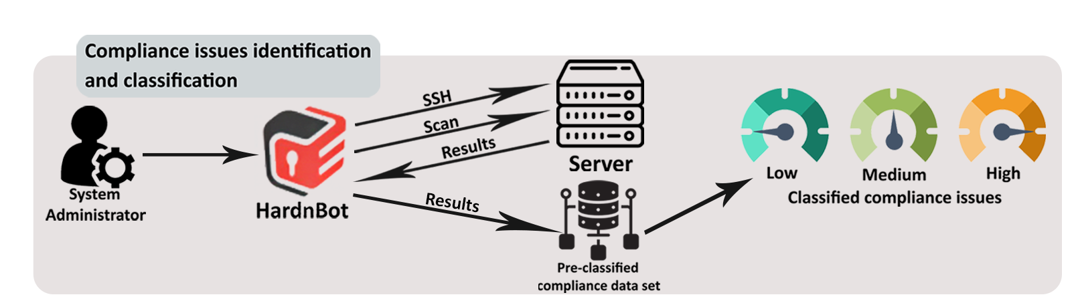
Task | W.M.K.M.W Wijekoon IT16167742

Slide 5
Task | G.G.L Anjula IT16022416
100%
Setup SSH connection to servers
100%
Implement backup function
100%
Abnormal behavior detection
Implement rollback function when abnormal behavior is detected

Slide 6
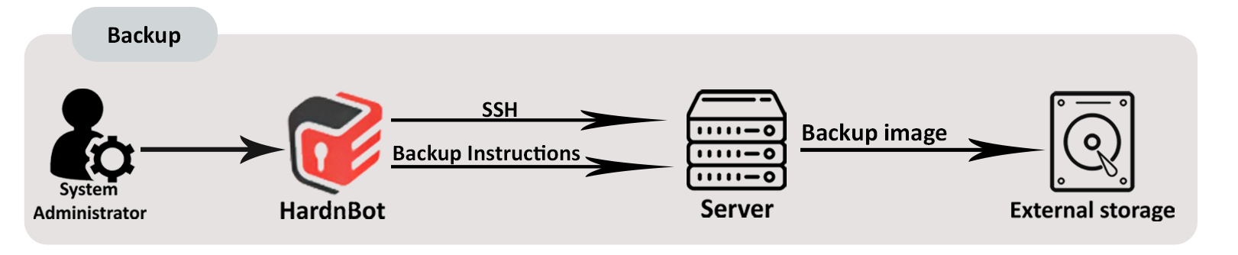
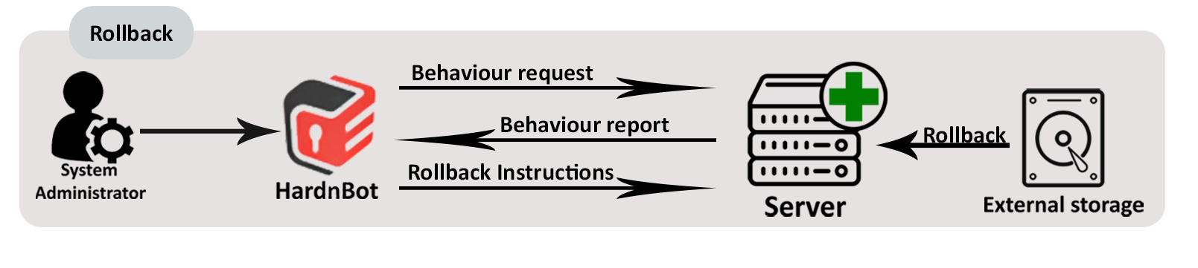
Task | G.G.L Anjula IT16022416

Slide 7
Task | R.M Budditha Rathnayake IT16054400
100%
Design interface for Intelligent hardening and Implement hardening function
80%
Implementation of Customizable Hardening function and Interfaces
80%
System Integration

Slide 8
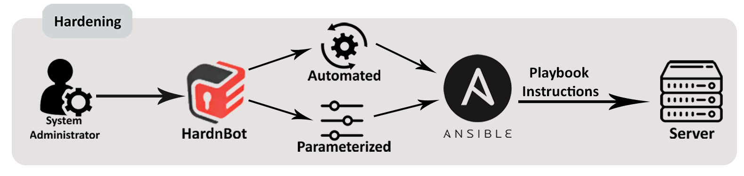
Task | R.M Budditha Rathnayake IT16054400

Slide 9
Task | Aruna Shan H.G.R IT16099746
70%
Using classified compliance issues , Predict the overall risk score of the server
75%
Display the asset value to be threaten
90%
Design interface for Reporting.

Slide 10
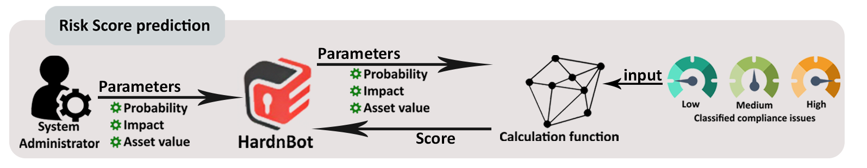
Task | Aruna Shan H.G.R IT16099746

Slide 11



Thank You ! | HardnBot

